Slide 1

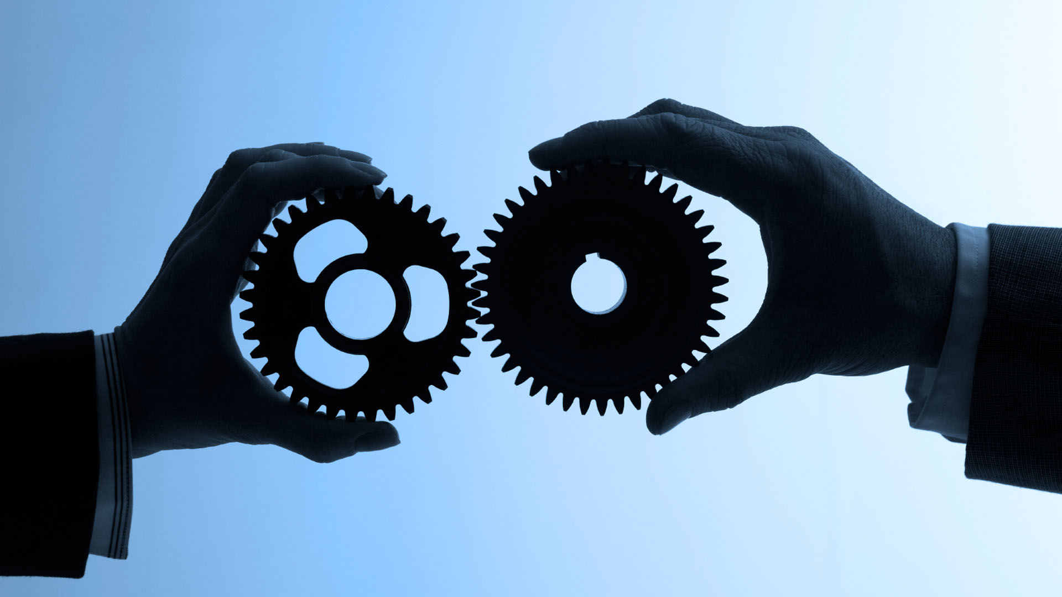
Mobile Human Computer Interaction I
Predictive one finger text input
Johann Albach, Sebastian Hartwig, Kaith Menken, Daniel Eischer

Slide 2
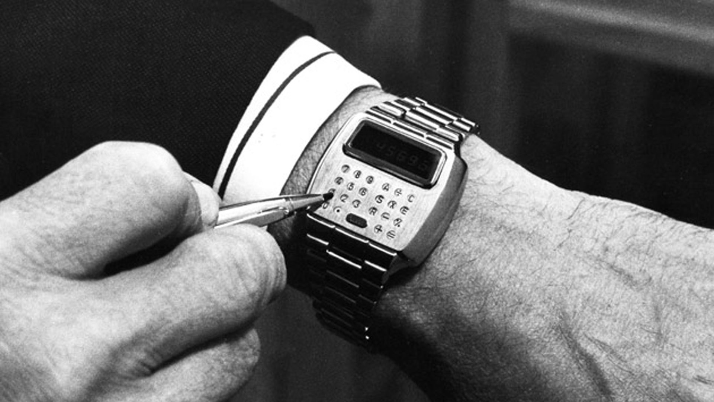
Technologie yesterday

Slide 3
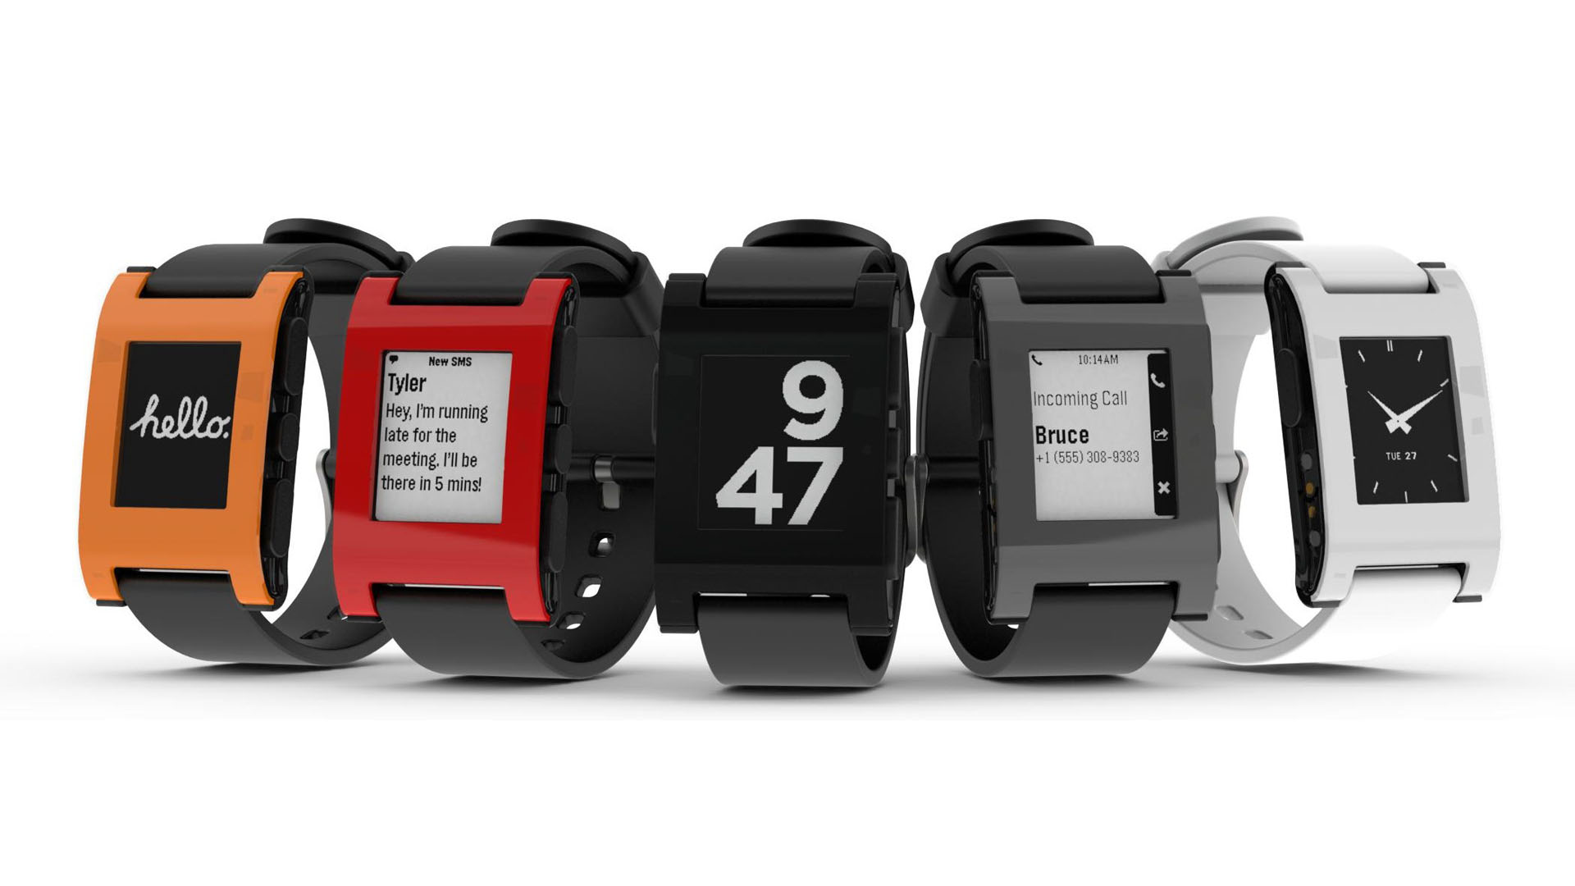
Technologie today

Slide 4
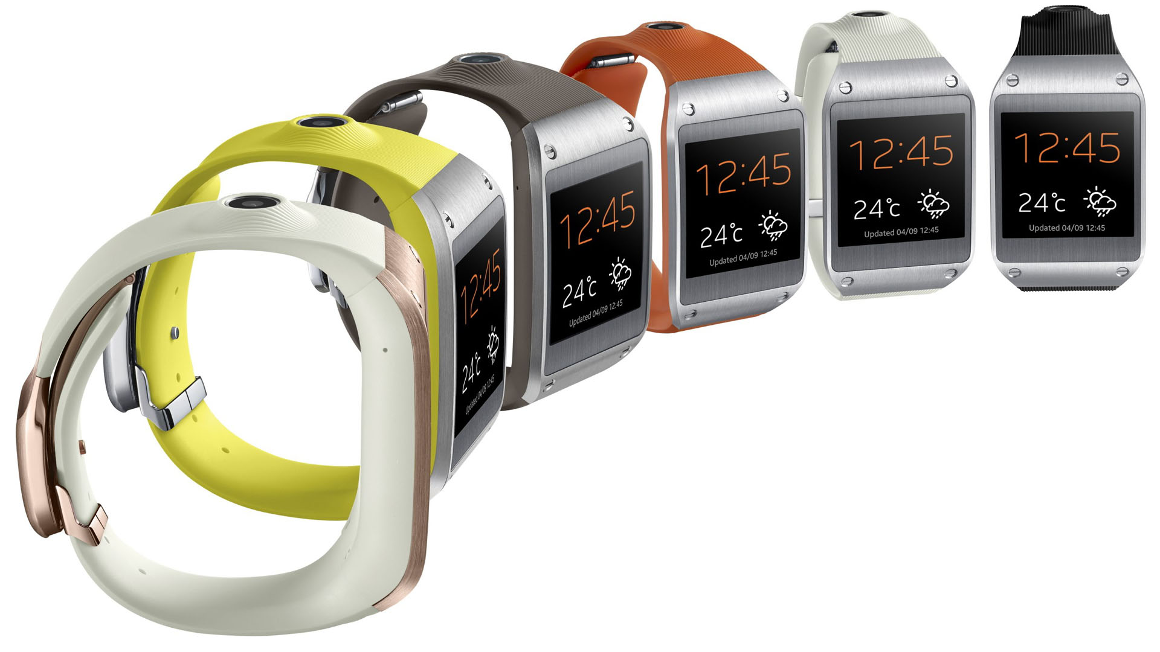
Technologie today

Slide 5
Look into the Future

Slide 6
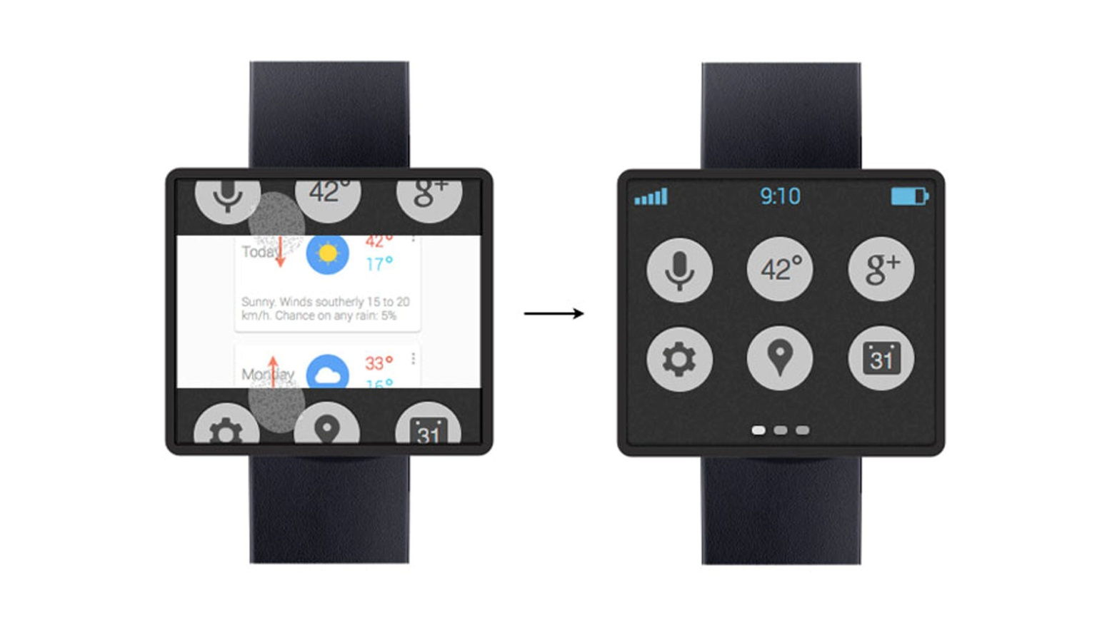
A glimpse into the future

Slide 7
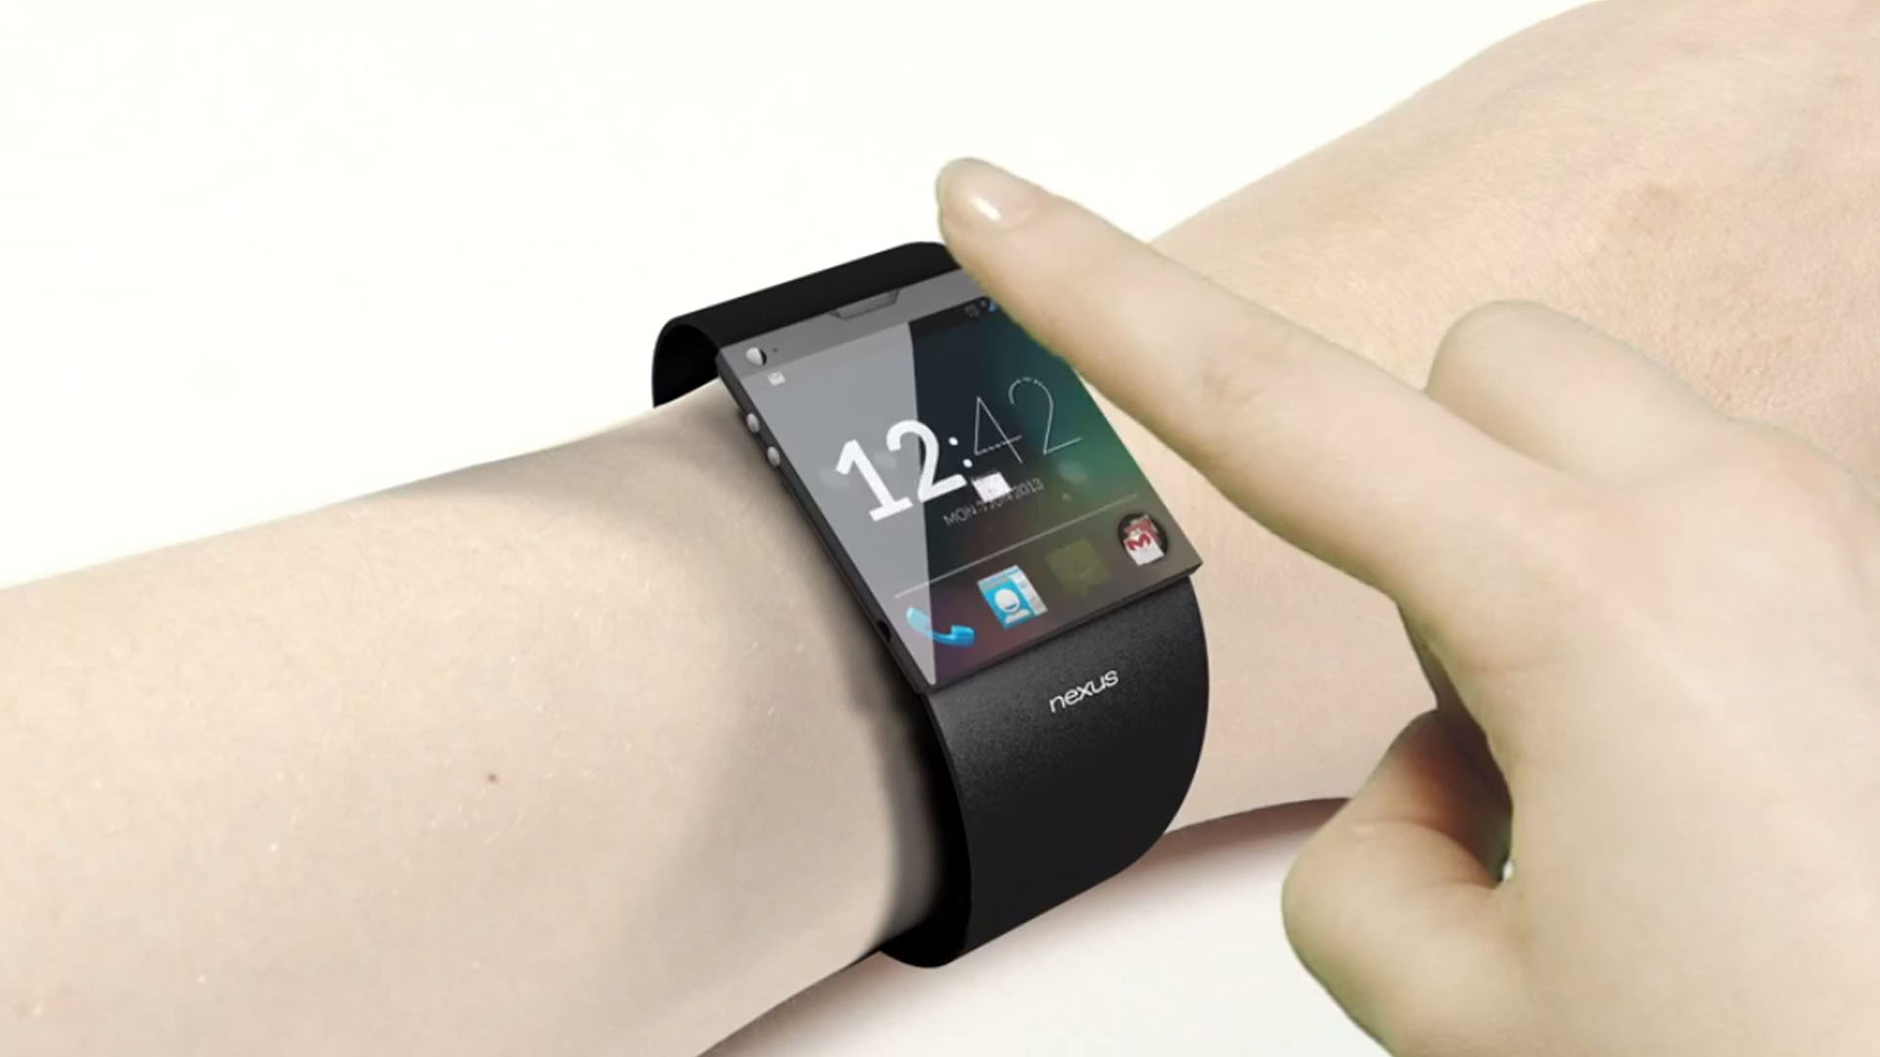
A glimpse into the future

Slide 8
A glimpse into the future

Slide 9
Our Idea (Introduction)
Single handed

Slide 10
The concept

Slide 11
Key features

Slide 12
Key features

Slide 13
Key features

Slide 14
Implementation

Slide 15
Sources
http://philmckinney.com/wp/wp-content/uploads/2012/03/iStock_000016662401Medium.jpg
http://images.bwbx.io/cms/2013-01-28/0128_GWatch_630x420.jpg
http://www.technobuffalo.com/wp-content/uploads/2013/03/Google-Smartwatch-Concept.jpg

